Slide 1
Twister Group Project — Final Product
Wizards of IoT

Slide 2

Original Intentions
Redesign the classic game of Twister with new features
Hands free “Spin the Dial” action
Voice IO
8X8 Sense Hat Display

Slide 3
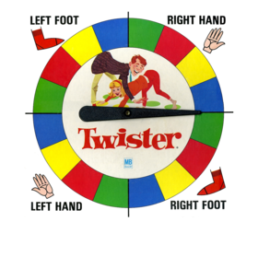
Developments
Sense Hat Display
Use sense hat led display to output next/current command
Voice-In
Using PicoVoice AI’s “Porcupine” Hot-word Detection
Voice-Out
Using PlaySound and Google Text-to-Speech

Slide 4
The Twister Code
Start by developing the basic structure for a Twister program
Randomized values for hand/foot, left/right side, and color selection
Smart dial to prevent overloading specific colors
Next step: implement specific features to the base program

Slide 5
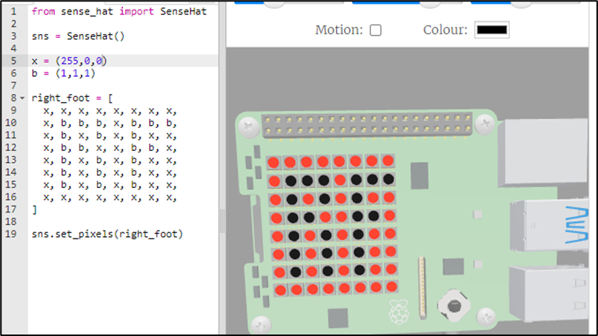
Visual Display Code Implementation
Issues:
Developing the visuals without the pi in my possession
Resolution: Found sense hat simulator

Slide 6
Voice in Implementation

Slide 7
Voice output Implementation

Slide 8


Demonstration

Slide 9

Thank you! Comments / Questions?

